Slide 1
Introduction to Beekeeping session one :- introduction
Welcome
to
Barkston Ash Beekeepers Association

Slide 2
House Keeping

Slide 3
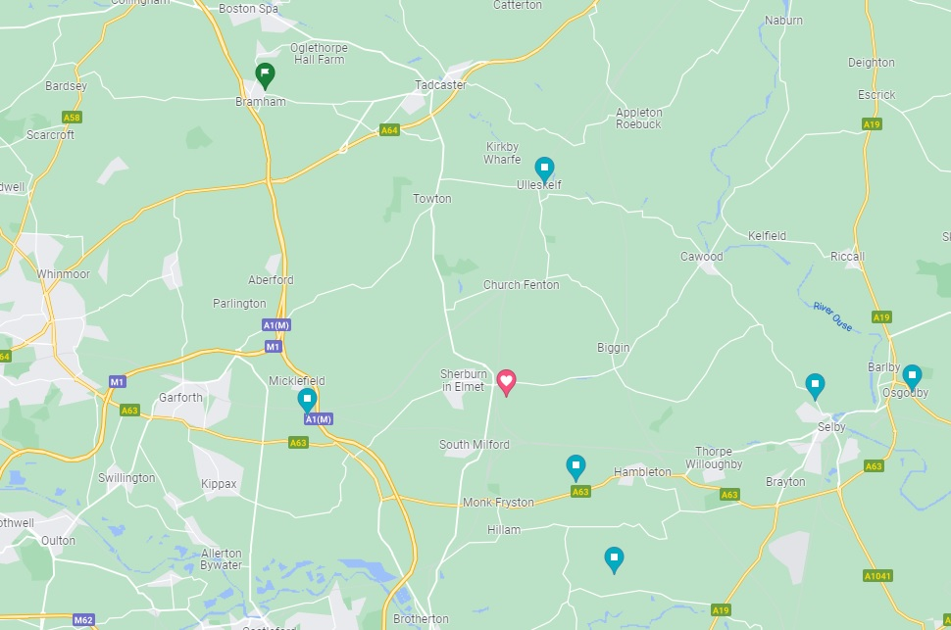
Barkston Ash Beekeepers Association
Location
Burton Salmon village hall

Slide 4
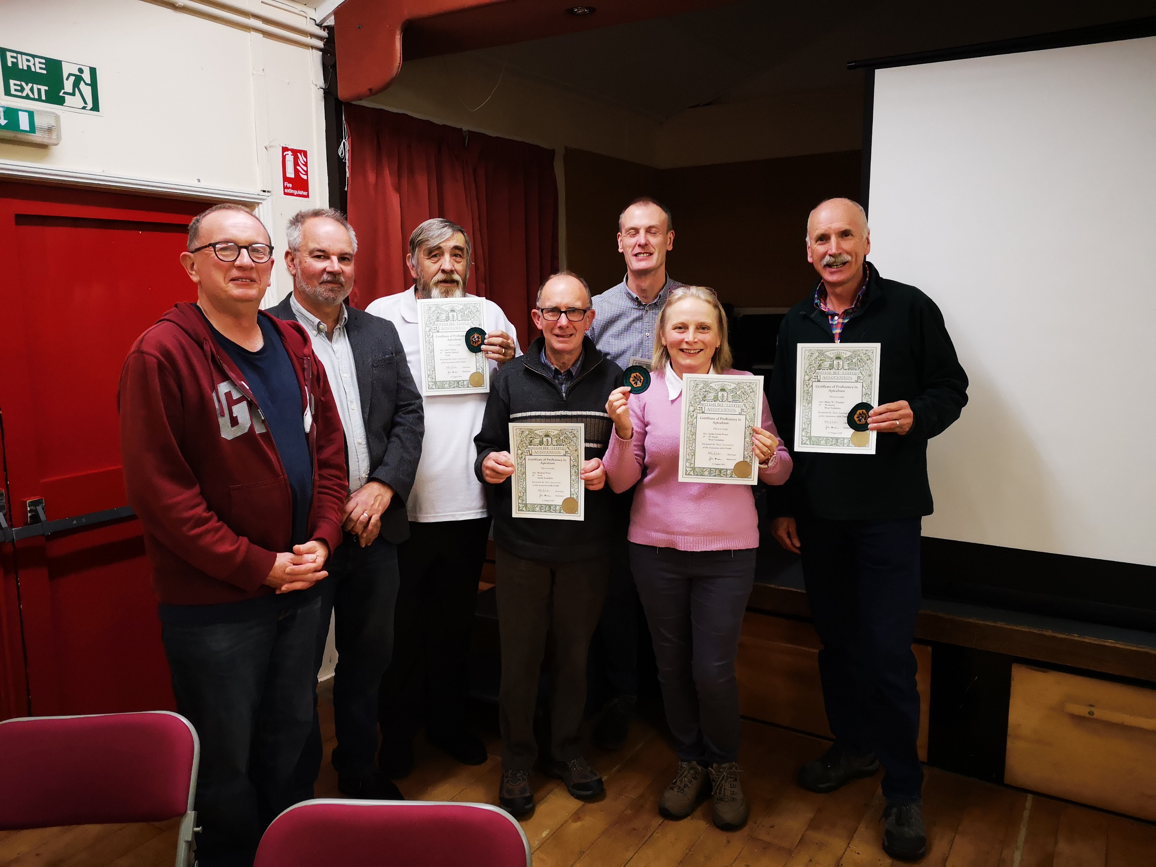
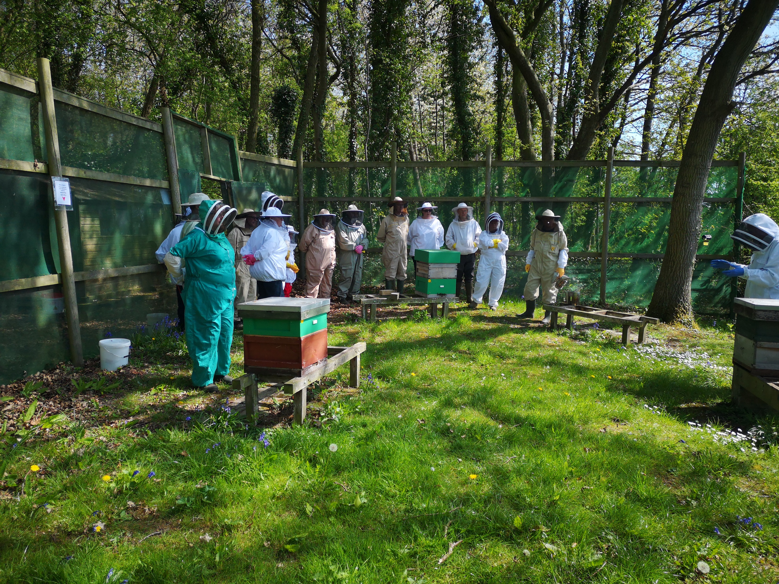
Beekeeping support
Local Branches (Barkston Ash BKA)
Training
Mentoring
Local events
County Associations (Yorkshire)
Representation to BBKA
Public shows
Larger training events
National (BBKA)
Assessments/Standards
Insurance
Policy
Government liaison etc.
Public Interface
Notes:
Change this to show your county and local associations

Slide 5
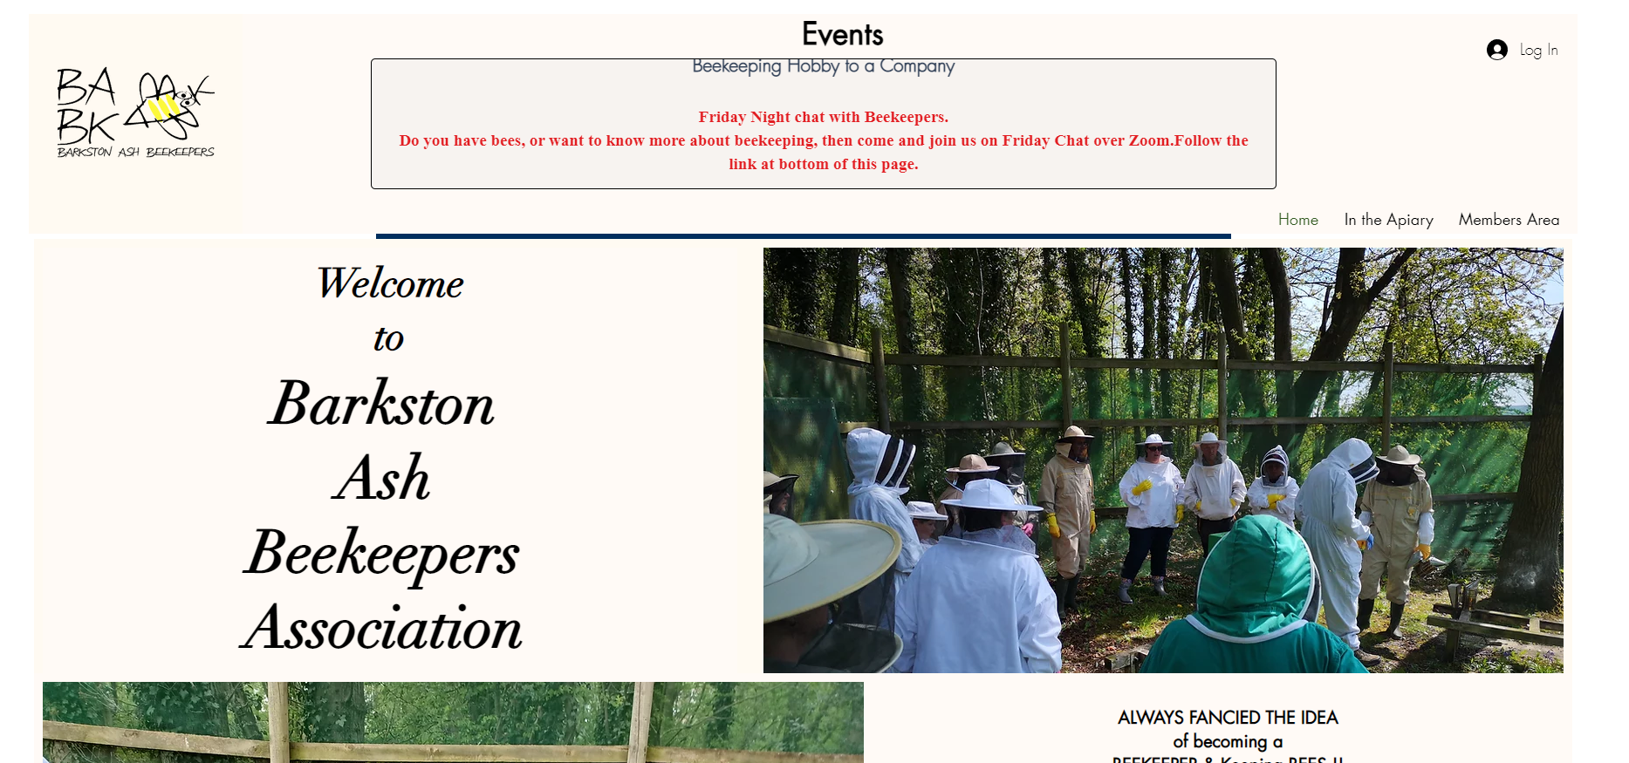
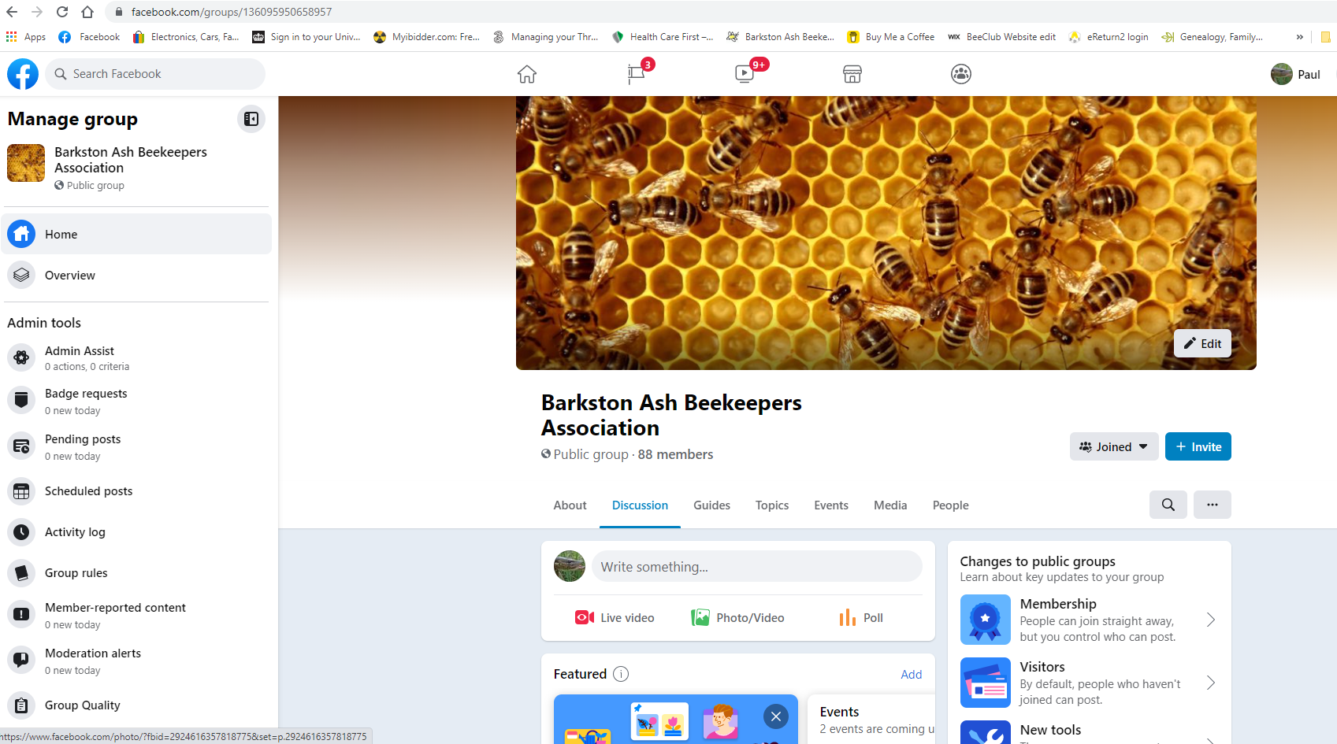
Barkston Ash Beekeepers Association
We have a Website
https://www.barkstonashbees.com
We also have a Face Book Page https://www.facebook.com/groups/136095950658957

Slide 6
Introductions to BABKA Committee
Mary-Jane Murray: Chairperson & YBKA Rep
Sarah Atkinson: Club Secretary and events coordinator
Caroline Oades: Treasurer
Claire Tolley: Association Education/Exams Officer
Paul Vickers: Association Apiary Manager & Website Manager
Dave Foster: Apiary Assistant

Slide 7
Your Tutor for this course
Greg Sharp
Tutor
Lives in Cawood
17 years Beekeeping
Technical support
Paul Vickers
Website & Apiary Manager
Lives in Burton Salmon
7 Years beekeeping

Slide 8
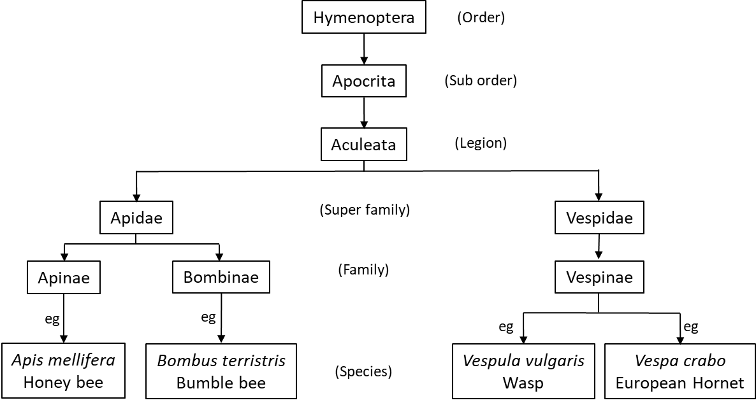
What are honey bees?
Hymenoptera
Includes bees, wasps and ants
Notes:
Honey bees thought to have evolved from wasps.
All this class of insect derived from insects with ovipositors that have become redundant and developed into a sting mechanism. This is why only female wasps and bees are able to sting!!Apocrita=narrow waist Aculeata = sting bearing
Pollinating insects and flowering plants developed concurrently about 110 - 170 million years ago. These insects were solitary and nectar and pollen were only part of their diet. The social bees (Bombus) developed about 50 - 60 million years ago and it is believed that honey bees (Apis) only developed about 20 - 30 million years ago.
Bees wasps and hornets most closely related.

Slide 9
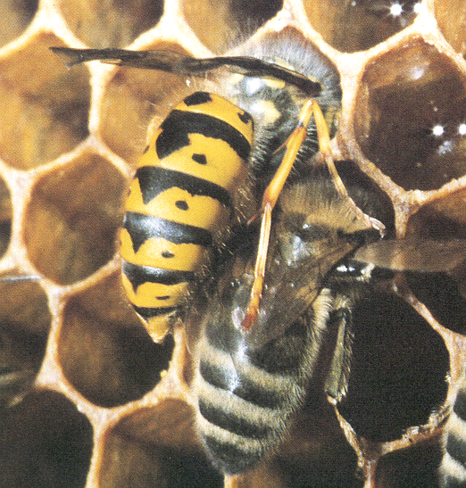
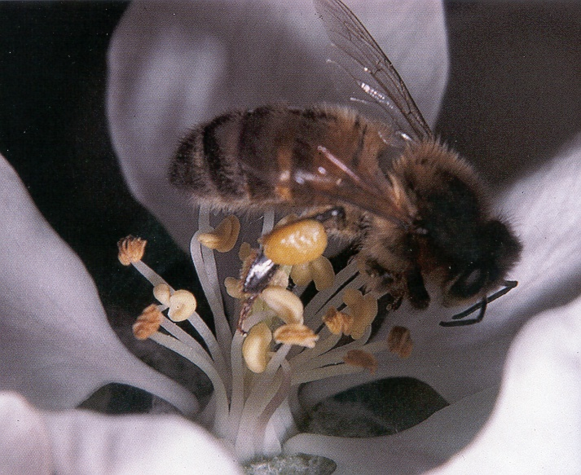
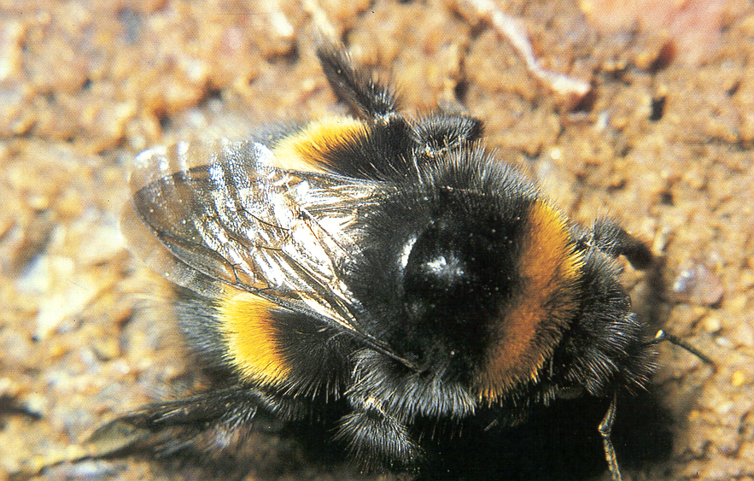
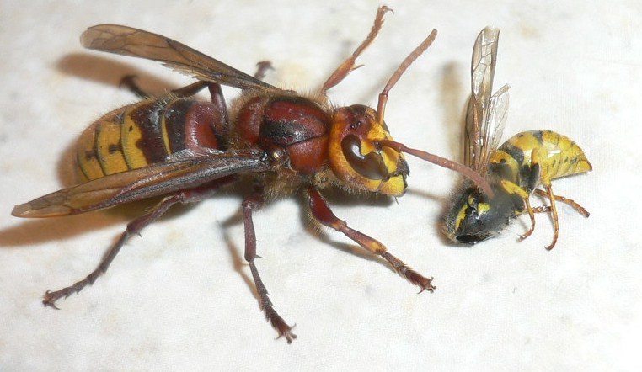
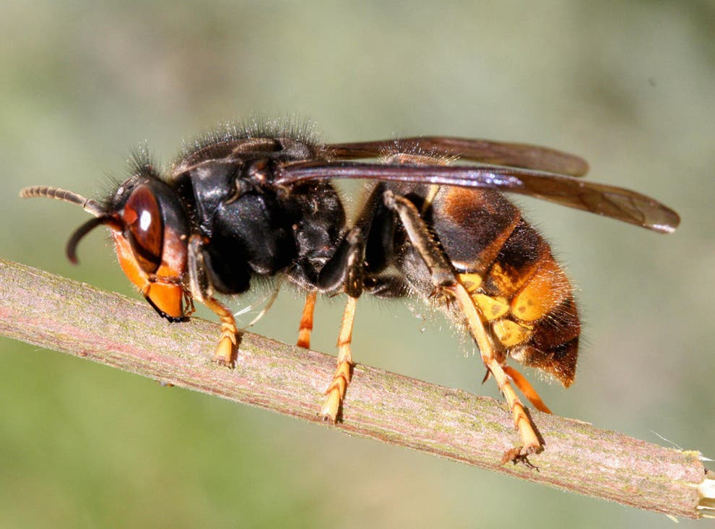
Bees, Wasps and Hornets
Honey bee
Apis mellifera
Bumble bee
Bombus terrestris
Wasp
Vespula vulgaris
Asian Hornet
Vespa velutina
European Hornet
Vespa crabro
Notes:
Talking here of European hornet not really a threat to honey bees.
Asian Hornet which may have read or heard about in press – different is serious threat to honey bees will learn more about this in future session.
20,700 bee species world wide and counting.
270 bee species in the uk.

Slide 10
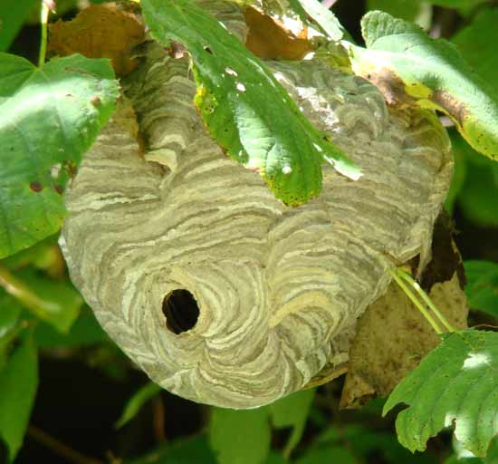
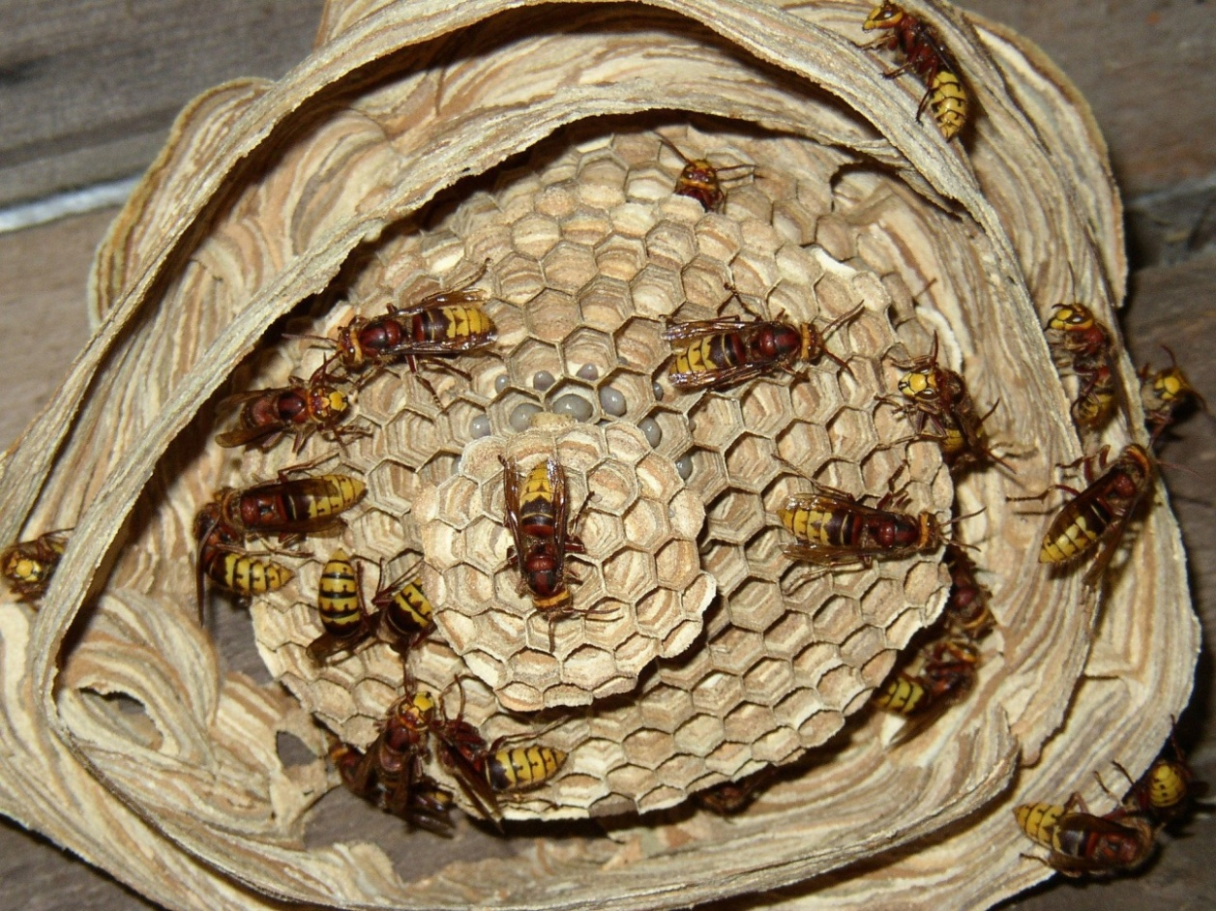
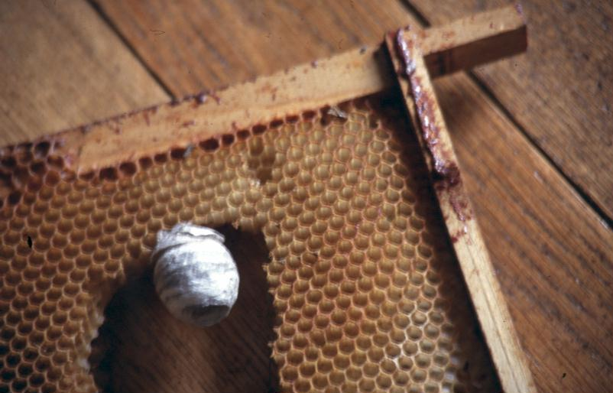
Wasp nests
Notes:
Made of paper – chewed wood
Cells hang downwards
Larvae fed on other insects - carnivores
10

Slide 11
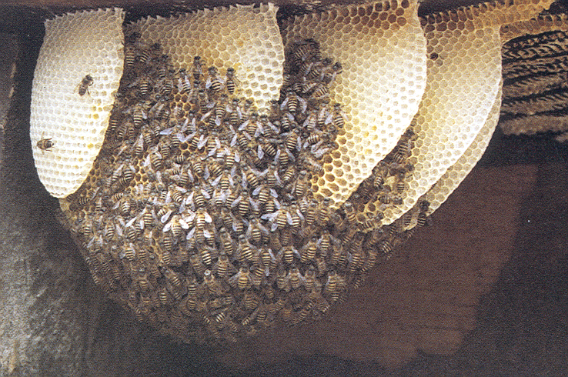
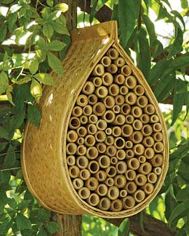
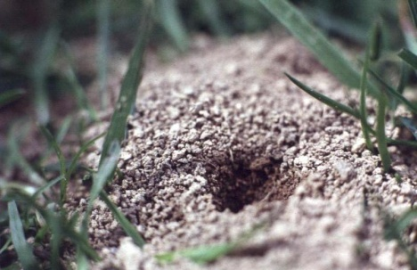
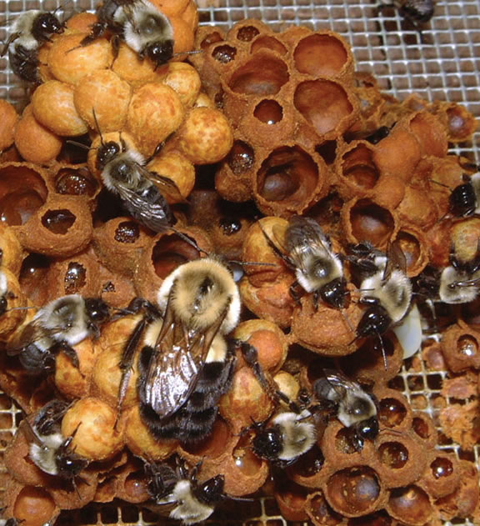
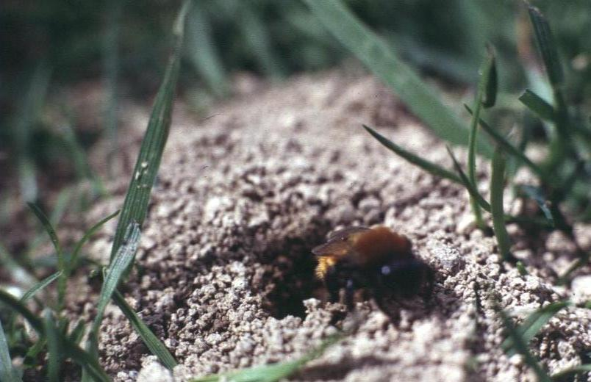
Bee nests
Notes:
Bumble bee - Haphazard
Solitary bees – this manmade but in nature find similar places.
Solitary bees – ground nesting
Honey bee nest – Apis cerana – Asian honey bee, regular, well-organised
Samples of wasp nest and honey comb to examine in break.
11

Slide 12
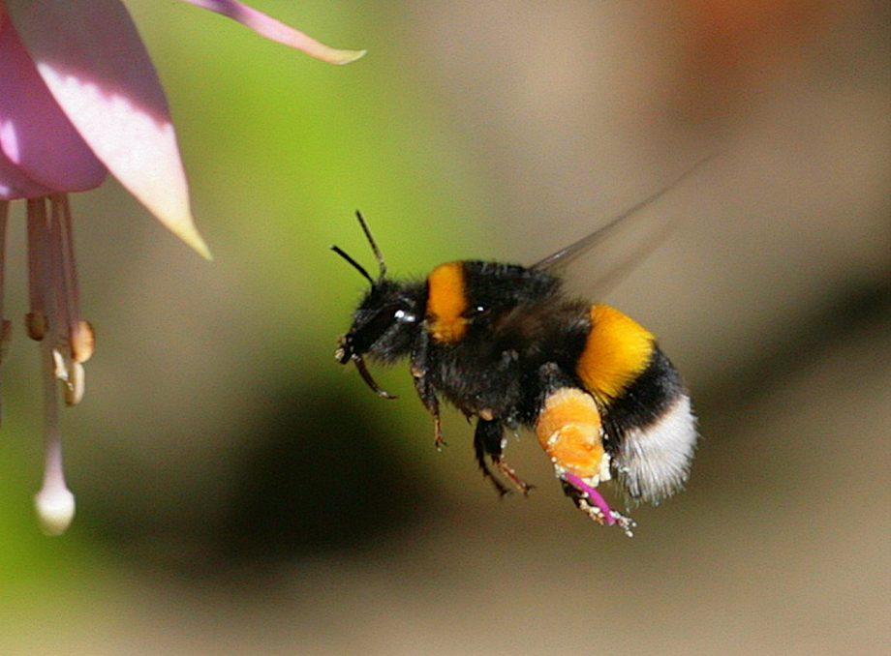
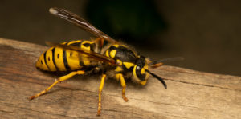
Annual cycle Bumble bees & Wasps
Winter
Solitary Queen
Hibernates
Autumn
Mated Qs find overwintering site
Drones and Workers die
Spring
Q builds nest
Q raises first worker brood
Late spring into summer
Q lays eggs
Workers raise brood
Late summer
Queen stops laying & dies
Virgin Queens and Drones mate
Summer
Colony built up
New Queens and Drones raised
Notes:
Talk thru this as the slide unfolds, many people do not know this and it is helpful to show the major differences between honey bees and other social insects

Slide 13
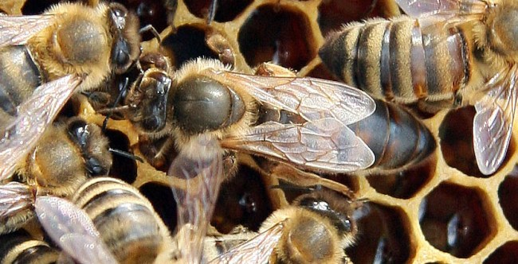
Annual cycle honey bee colony
Winter
Queen & workers
Cluster to keep warm
Little brood production or foraging
Consume stores
Autumn
Clustering starts
Q & workers
Final drones evicted
Foraging reduced
Spring
Q Increases laying rate
Workers start foraging
Late spring into summer
Brood production peaks
Drones produced
Often good nectar flow
Possibility of new Queens & swarming
Late summer
Queen reduces laying
Winter bees produced
Store building for winter
Eviction of drones starts
Summer
Colony at peak
New Queens & Swarming still possible
Swarming – colony reproduction
New colony founded
Notes:
Useful to point out that the reason that we can get honey from bees is that they store enough to over winter as a colony. Reproduction is the reproduction as a colony/super organism.

Slide 14
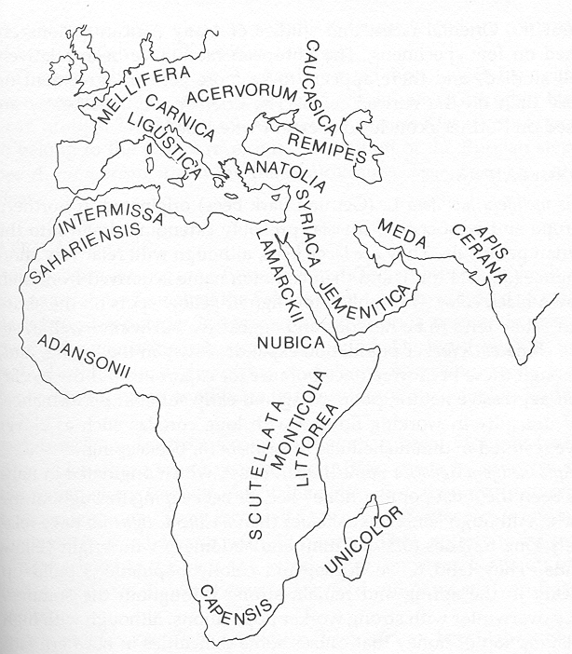
Origins of honey bees
Apis mellifera spp
Grey bee - also popular
Apis mellifera carnica
British bee
Apis mellifera mellifera
Italian bees – most popular world wide
Apis mellifera ligustica
European Bees originated near here
Asian honey bee
Apis cerana
South east asia now thought to be the origin of honeybees.
Ex: Biology of the Honeybee by Mark Winston
Notes:
Forebears of modern Bees (Apis mellifera) originated Africa
Moved through Africa to Europe.
There are many subspecies with different characteristics. Most notable these days are; the British black bee (Apis mellifera mellifera); the Italian bee (Apis mellifera ligustica) and the Grey bee (Apis mellifera carnica).
there were no honey bees in America until humans brought them from Europe
Some honey bees moved across to India whilst India and Africa were adjacent (Continental drift). These have developed into specific species that cannot interbreed with the European/African bees.

Slide 15
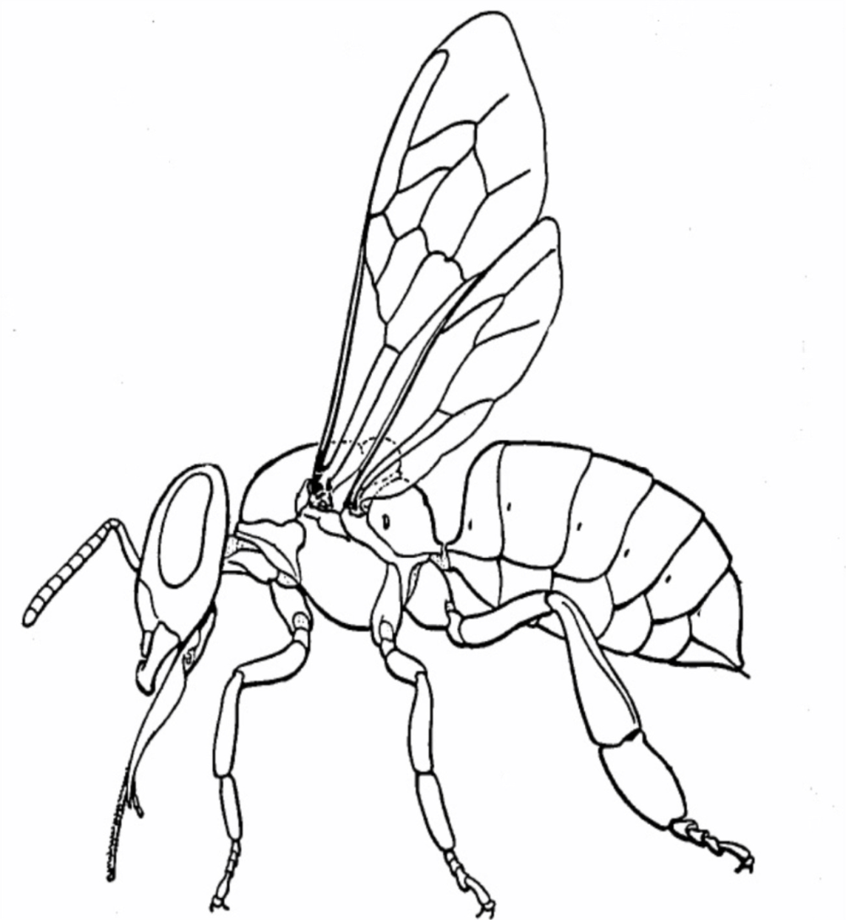
Anatomy of the Bee
Head
Thorax
Thorax
Wings (pairs)
Simple eyes
(Ocelli)
Spiracle (breathing aperture)
Abdomen
Compound eyes
Antenna
Sting
Mandibles
Tongue (glossa)
Pollen Basket (corbicula)
Legs
Notes:
If honey bee model available use them

Slide 16
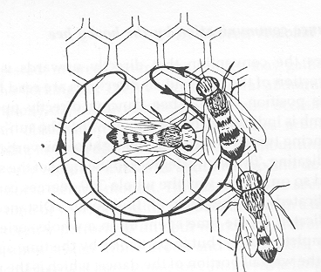
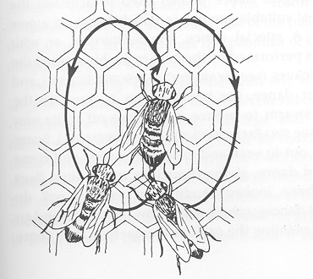
Bee Dances: Where's the food
Round Dance
(General location)
food nearby
Waggle Dance
(Precise location)
food further away
Ex: Encyclopaedia of Beekeeping by Morse & Hooper
Notes:
Use dances to communicate where to find food, water & a new home when swarming.
Dark in hive – communication by touch, vibration & smell.

Slide 17
Why do we need bees?
“Bees and other pollinating insects are responsible for providing the ‘high quality’ food for mankind”
Professor Keith Delaplane
Bees/pollinators are the ‘canary in the cage’ indicating the health of the environment
Notes:
Without pollinating insects food would be bland, lose all coloured fruit and veg.
The environment that your honey bees are in is also shared by other pollinators if your bees are doing poorly then others are probably struggling as well

Slide 18
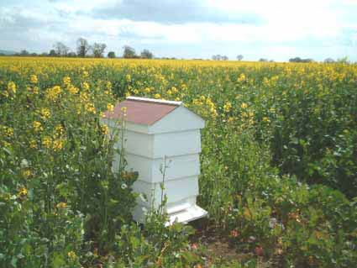
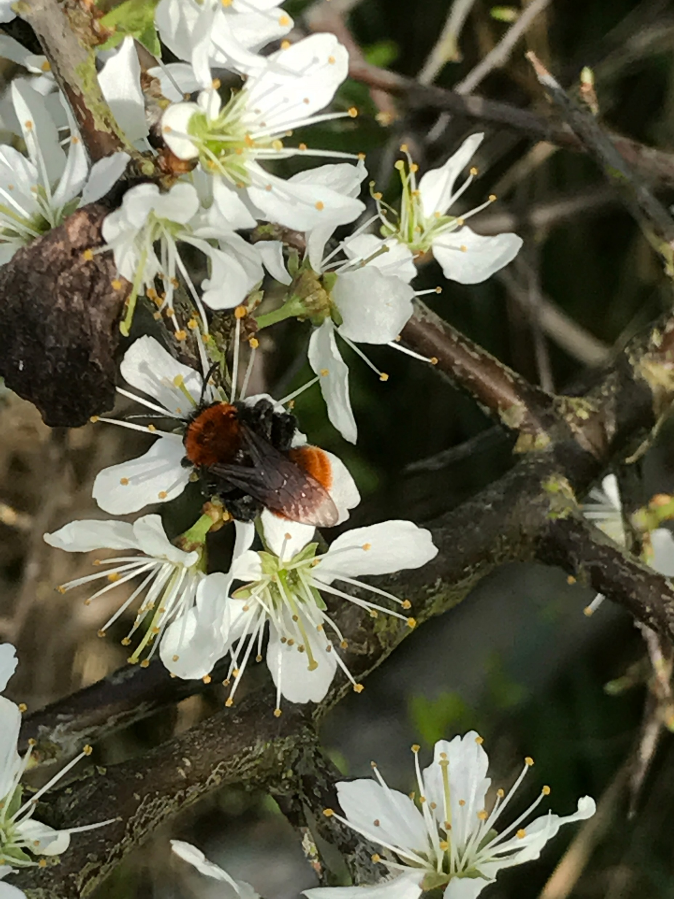
Plants pollinated by honey bees
Top Fruit
OSR +10%
Soft fruit
Salad crops – (for seed)
Blackthorn/Hawthorn
Beans
Notes:
Oil seed rape is a wind pollinated species but yields better and more evenly when insect pollinated

Slide 19
Importance of Beekeeping
UK consumption of honey
UK production of honey
Value to UK agriculture
85% of food crops rely on pollinators
Value to the environment
Number of beekeepers
Number of honey bee farmers
Number of colonies
Number of wild colonies
43,000 tons/yr
2,800 tons/yr (up and down depends on the weather)
£600m pa
~ ????????
~ 38,000 (C.E.H)
~ 500? (B.F.A)
~ 230,000 (C.E.H)
~ Very Rare
Notes:
These figures are from the last couple of years.

Slide 20
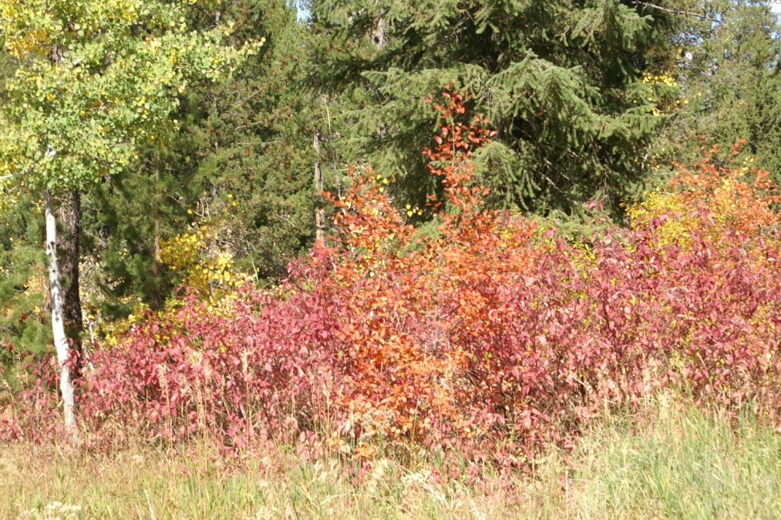
Environmental impact of no bees
No honey bee - no early pollinators
Less winter feed for birds
Changes in flora
Increase in grasses
Late pollinated plants

Slide 21
Equipment and clothing
Many suppliers of equipment – Like Thornes, Maisemore, Abelo,Claro bees Etc
Always compare prices (beware of quality V price)
Ensure you know what you are ordering get advice from association members
Notes:
This slide is to forestall the barrage of questions about what to buy and from where. If your association has a shop, or you buy for your members as a bulk order etc
A standard listing of the major supplies and any local ones is always useful.

Slide 22
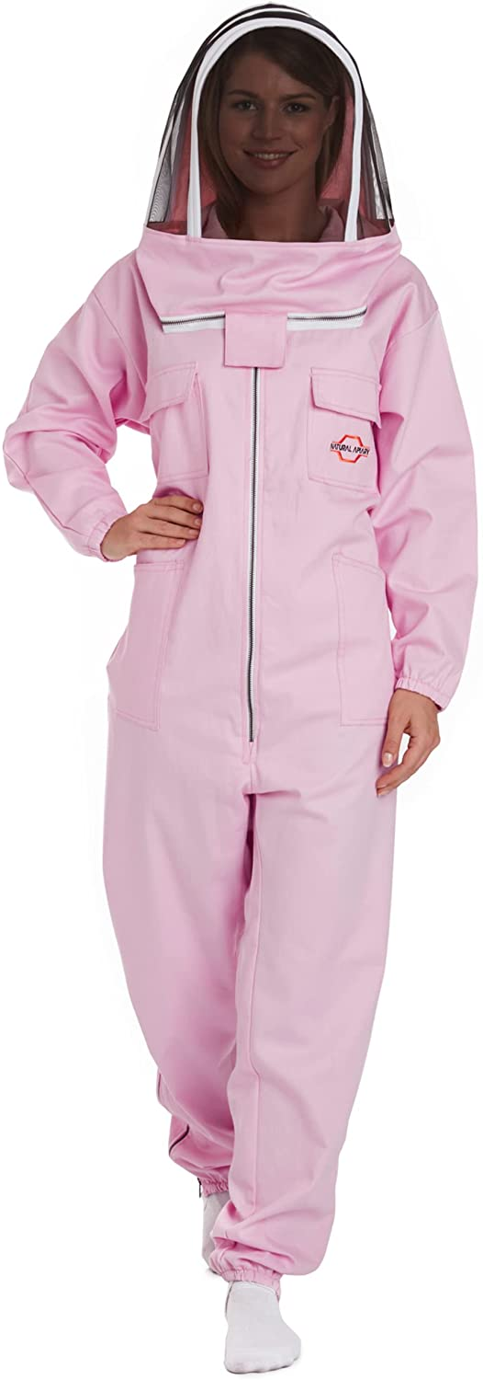
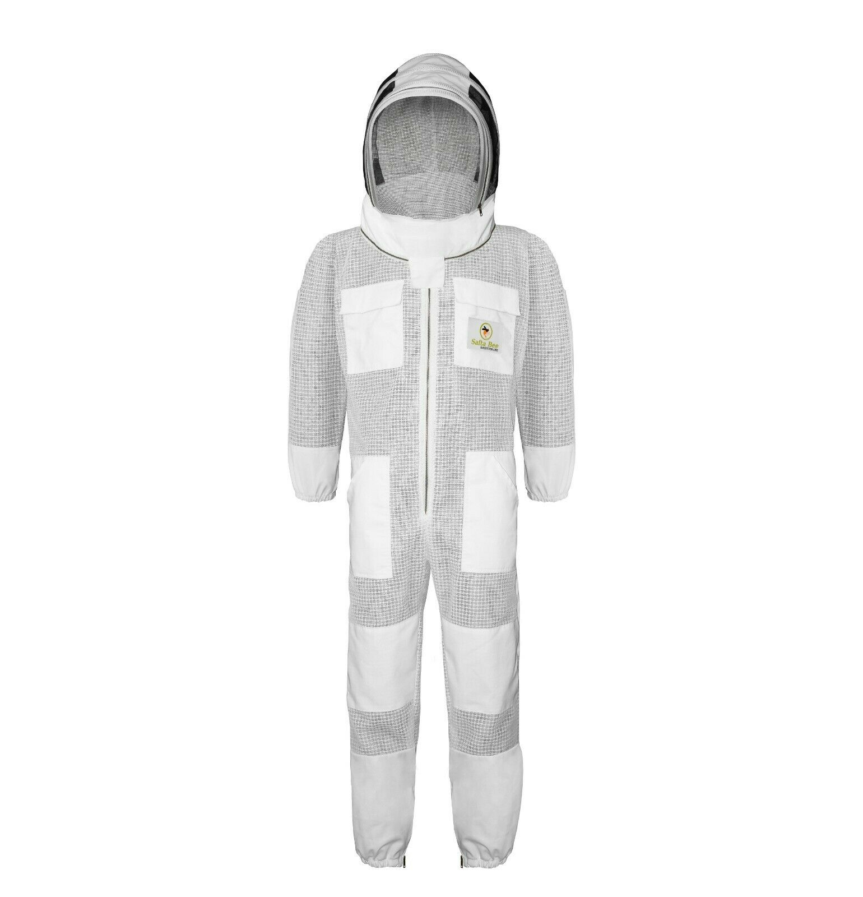
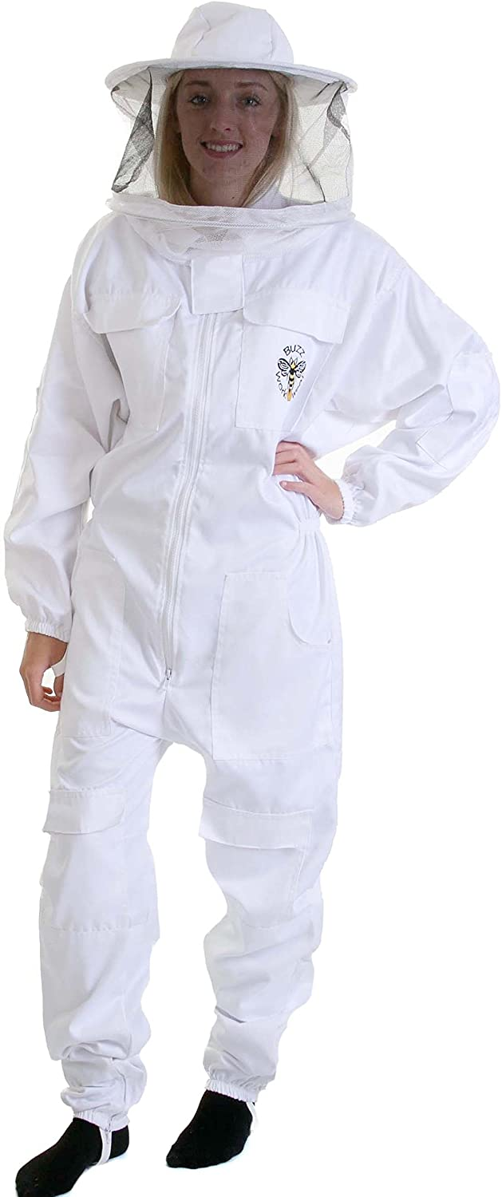
Equipment and clothing
Time to look at the gear needed
Ask any questions you like
Which suit is for you?
Notes:
Provision of a range of Suits / Jackets is useful for people to have a look at
Does your association have suits that are available on loan?

Slide 23
Hive tools and other equipment
Gloves
Drawing pins
Butler cage
2 Queen marking cages
Queen cell cage
Matches
Scissors
Uncapping tool
Mouse guard
Marking fluid
Spacers
Mesh
Smoker
Porter bee
escape
3 Hive tools
Notes:
Emphasise that not all of this is needed to start beekeeping. Association apiary or mentor will have equipment available for you to try before you buy.

Slide 24
Time for a cup of tea

Slide 25
The Honey Bee Colony

Slide 26
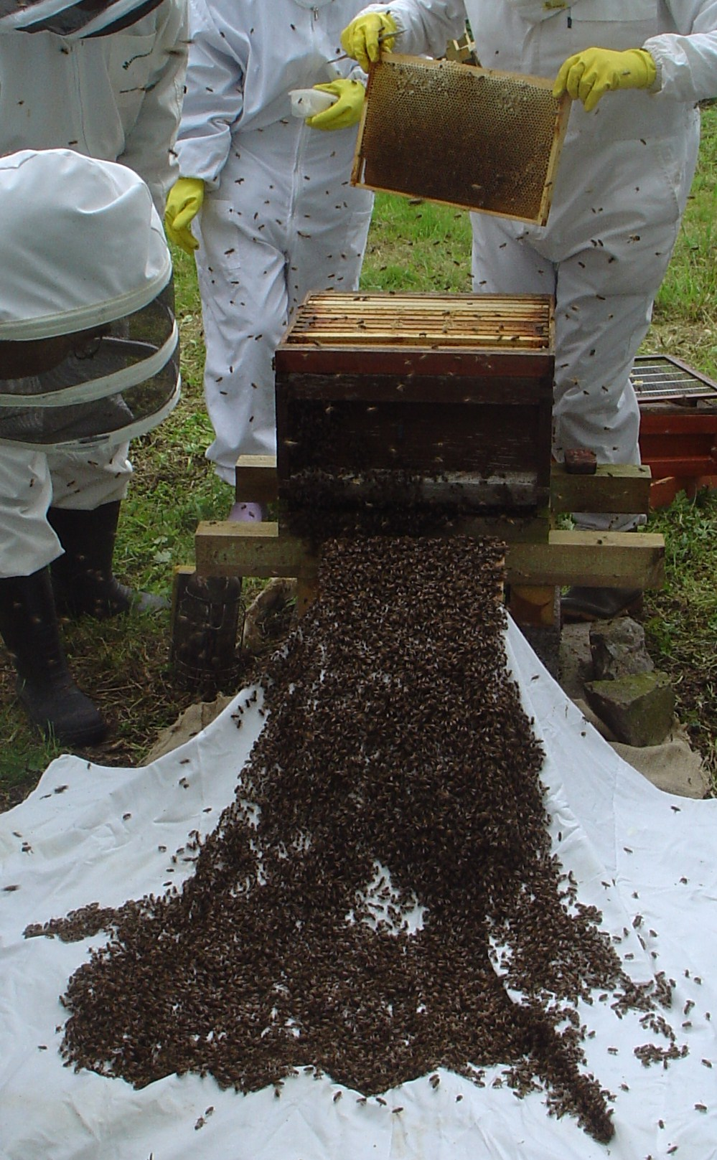
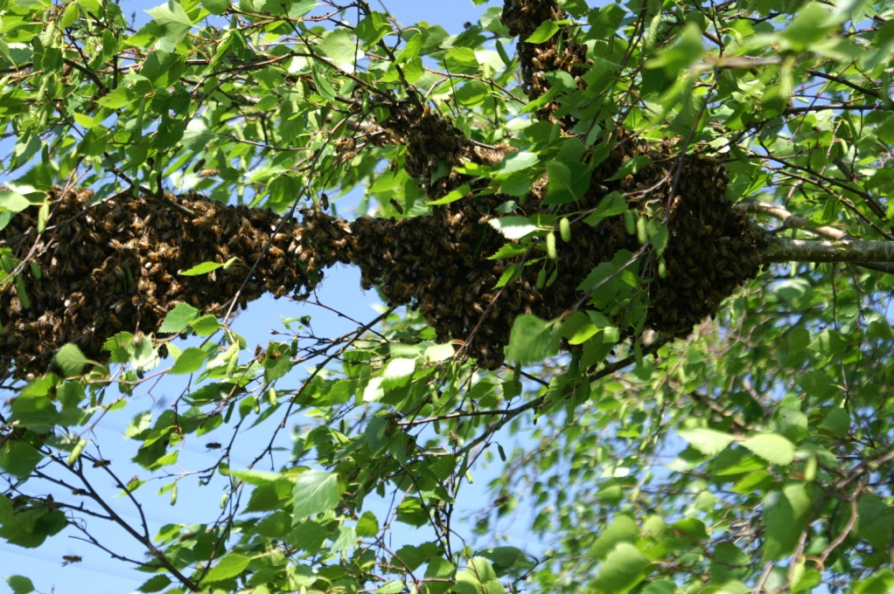
Superorganism
Individuals
Division of labour
Colony intelligence
Notes:
Individual bees cannot live or function alone.
Super organisms are collections of individual animals that act as a unit.
In superorganism individuals lose ability to procreate and develop specialist tasks that support the whole unit.
In many ways a super- organism can be likened to an animal where the cells have specialist roles (such as muscle, blood, lungs etc.)
It is interesting to note that within the superorganism there are very effective ways of communication (primarily using pheromones).These mechanisms allow the organism to react quickly to changing events or threats and give the appearance of high intelligence.

Slide 27
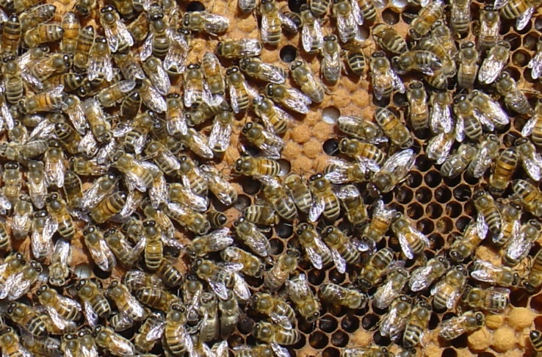
Queens, workers and drones
Two Genders (male/female)
Two Female Castes (queen/worker)
Male-Drone produced by:-
Parthenogenesis
Female –fertilised egg
Male -- unfertilised egg
Notes:
Point out worker and drone and capped brood including drone brood in corner

Slide 28
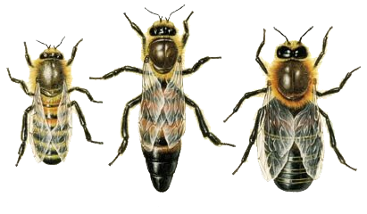
Two Castes & Two Sexes of Honeybee
Worker
Queen
Drone
Body shape comparison
Notes:
Differences may be obvious to you but not the beginners this is a useful place to start

Slide 29
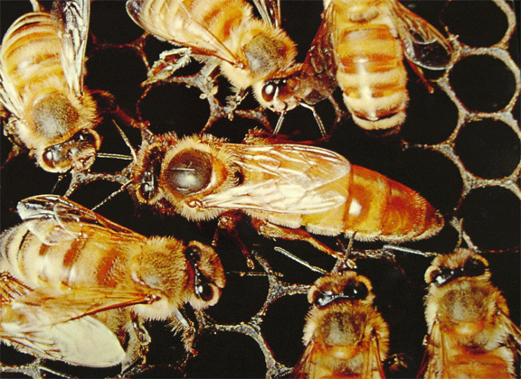
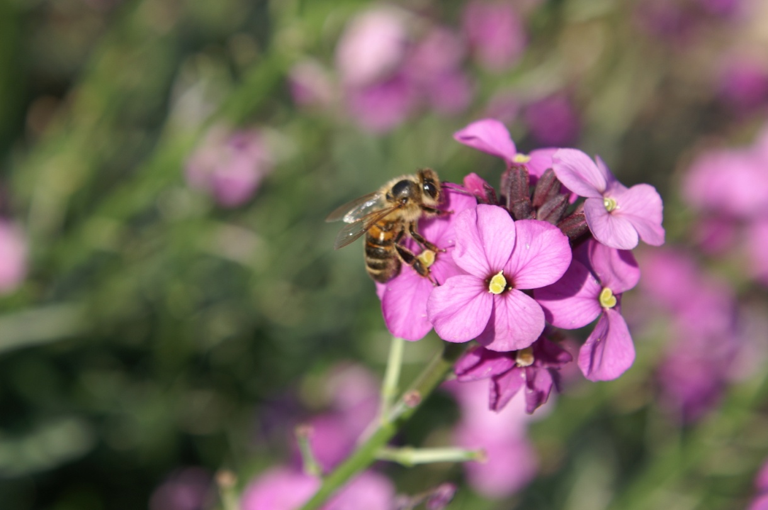
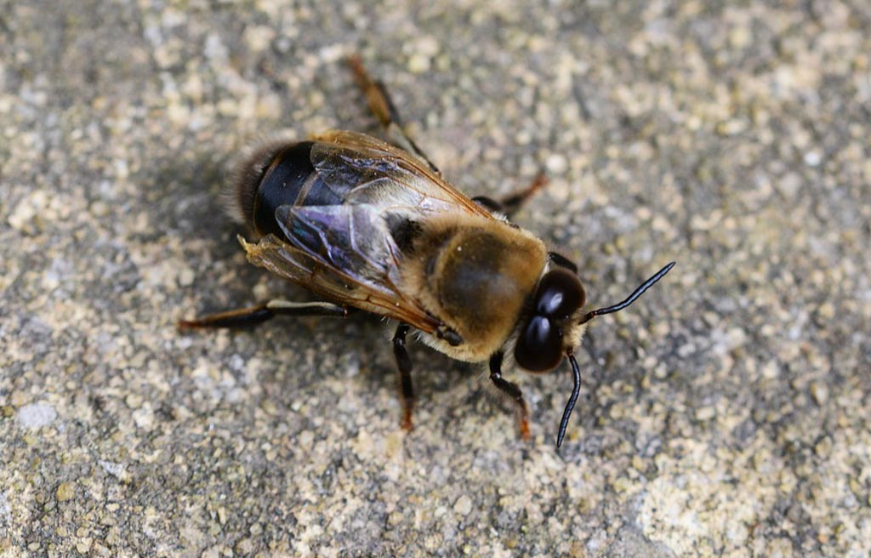
Honey bee castes and sexes

Slide 30
Number of bees in a colony
~60,000 workers
1 Queen
~2000 drones
but in winter
~10,000 workers
1 Queen
0 drones

Slide 31
Quiz How much do you remember From what I have told you
Notes:
Use as reminder and to get people to interact, this is not meant to be competitive

Slide 32
1
Name 2 insects that are related to honey bees

Slide 33
2
Do the insects you just named survive winter as a colony?

Slide 34
3
What do wasps build their nests from?

Slide 35
4
Can you harvest honey from bumble bees?

Slide 36
5
How do honey bees form new colonies?

Slide 37
6
Which continent do honey bees originate from?

Slide 38
7
How many eyes does a honey bee have?

Slide 39
8
How do honey bees tell their nest mates where to find forage?

Slide 40
9
Is the UK a net importer of honey?

Slide 41
10
Name the 3 types of honey bee.

Slide 42
Answers

Slide 43
1
Name 2 insects that are related to honey bees
Wasps
Hornets
Bumble bees

Slide 44
2
Do the insects you just named survive winter as a colony?
No – only the queens overwinter

Slide 45
3
What do wasps build their nests from?
Paper – chewed wood pulp

Slide 46
4
Can you harvest honey from bumble bees?
Not easily and the nest would be totally destroyed.

Slide 47
5
How do honey bees form new colonies?
Colony reproduction is by swarming

Slide 48
6
Which continent do honey bees originate from?
Africa (South East Asia as a prime area of origin)

Slide 49
7
How many eyes does a honey bee have?
5 – 2 compound and 3 simple (ocelli)

Slide 50
8
How do honey bees tell their nest mates where to find forage?
They dance

Slide 51
9
Is the UK a net importer of honey?
Yes

Slide 52
10
Name the 3 types of honey bee.
Queen, worker - both female
Drone - male

Slide 53
Next session
The Hive/ Colony
Thank-you for listening
I look forward to seeing you next week

